Slide 1

DriverPass System Analysis
Dylan Coulter
Notes:
[No speaker notes required for this slide.]

Slide 2

System Requirements
Functional Requirements
The system must offer three different driving packages with the ability for future adjustment by owner or admin.
The system must provide practice test, online classes, and must be updated when changes are made to DMV policies and regulations.
Nonfunctional Requirements
The system for DriverPass ought to be web based this would be in the form of a website over the cloud.
If any errors, crashes, or glitches happen the admin must be notified immediately so the system can be up and functional again as fast as possible.
Notes:
Two Functional requirements for the DriverPass system that have been identified and that aline with the needs of the client are the offering of three different driving packages with the possibility for expansion in the future. The other functional requirement is the system needs to offer practice test and online classes while keeping everything up to date with current DMV policies and regulations. These functions of the system were discussed in the interview with the client and were identified as a focus of the system functionality. Two nonfunctional requirements identified are that the system should be web-based working over the cloud as this would be the best approach for the system considering cost and user satisfaction. The second nonfunctional requirement is that anytime an error, crash, or glitch happens the admin must be notified immediately so a process can be put in place to correct the issue. As system that has long outages is not good for customer satisfaction.

Slide 3
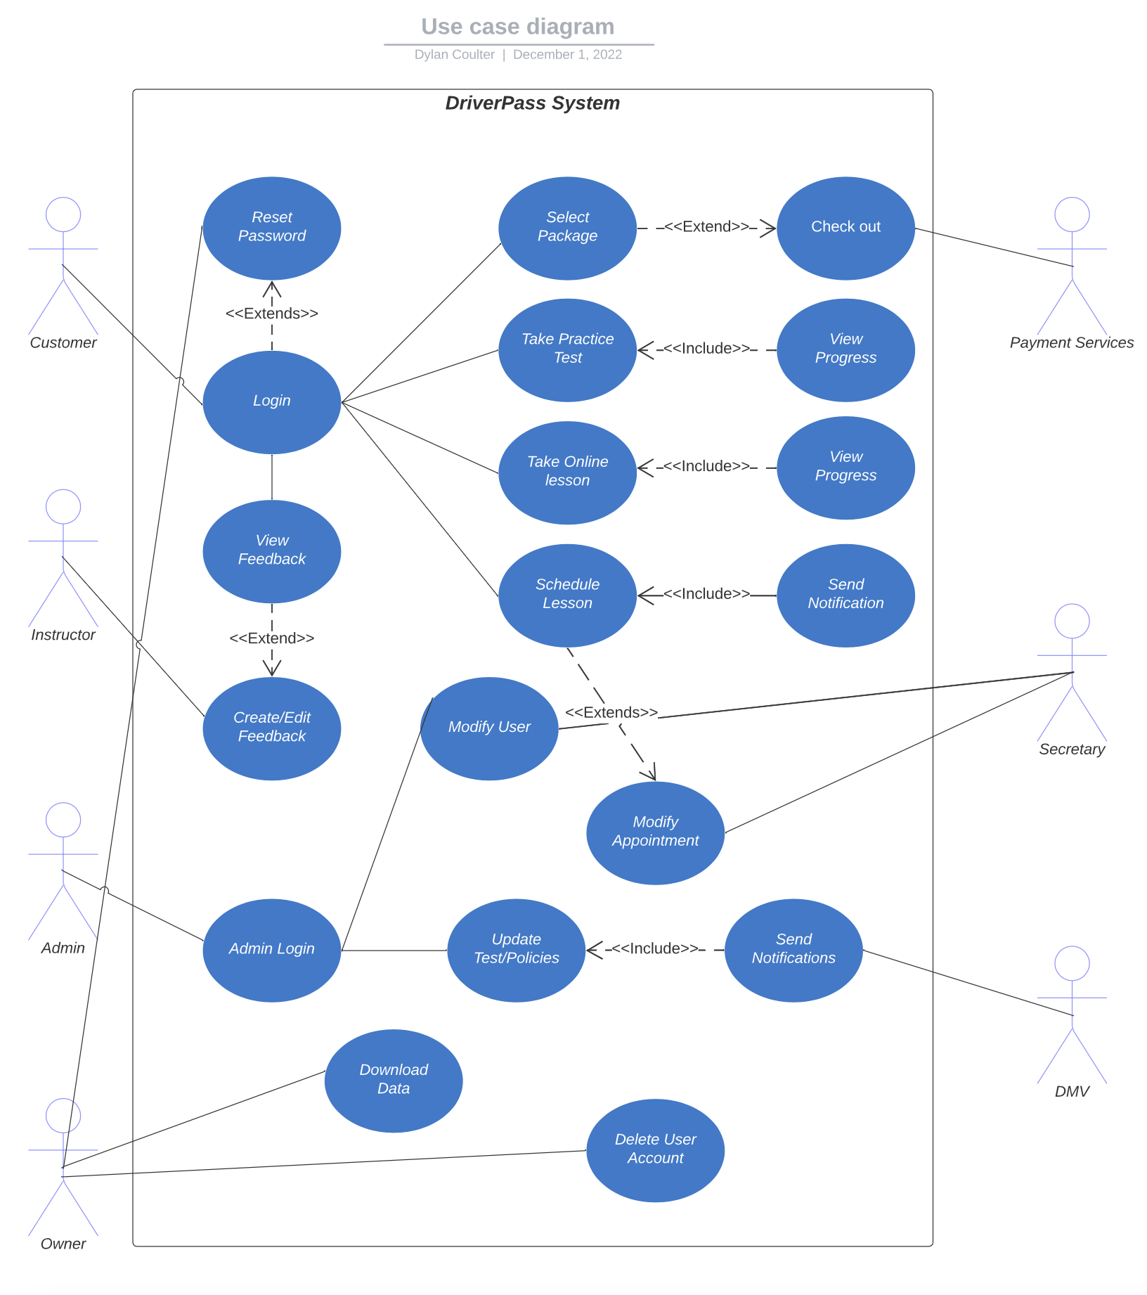
Use Case Diagram
Notes:
This is a use case diagram containing seven actors which include the owner, admin, customer, instructor, DMV, payment services, and secretary. The stick figures to the left of the system are called primary actors which means they can engage the system at anytime where the actors on the right do not engage the system unless they are called upon. The blue circles represent use cases which show us all the different task the system must be able to do and which actors interacted with the use case. Within the diagram everything that was discussed with the client DriverPass in the interview has been included.

Slide 4
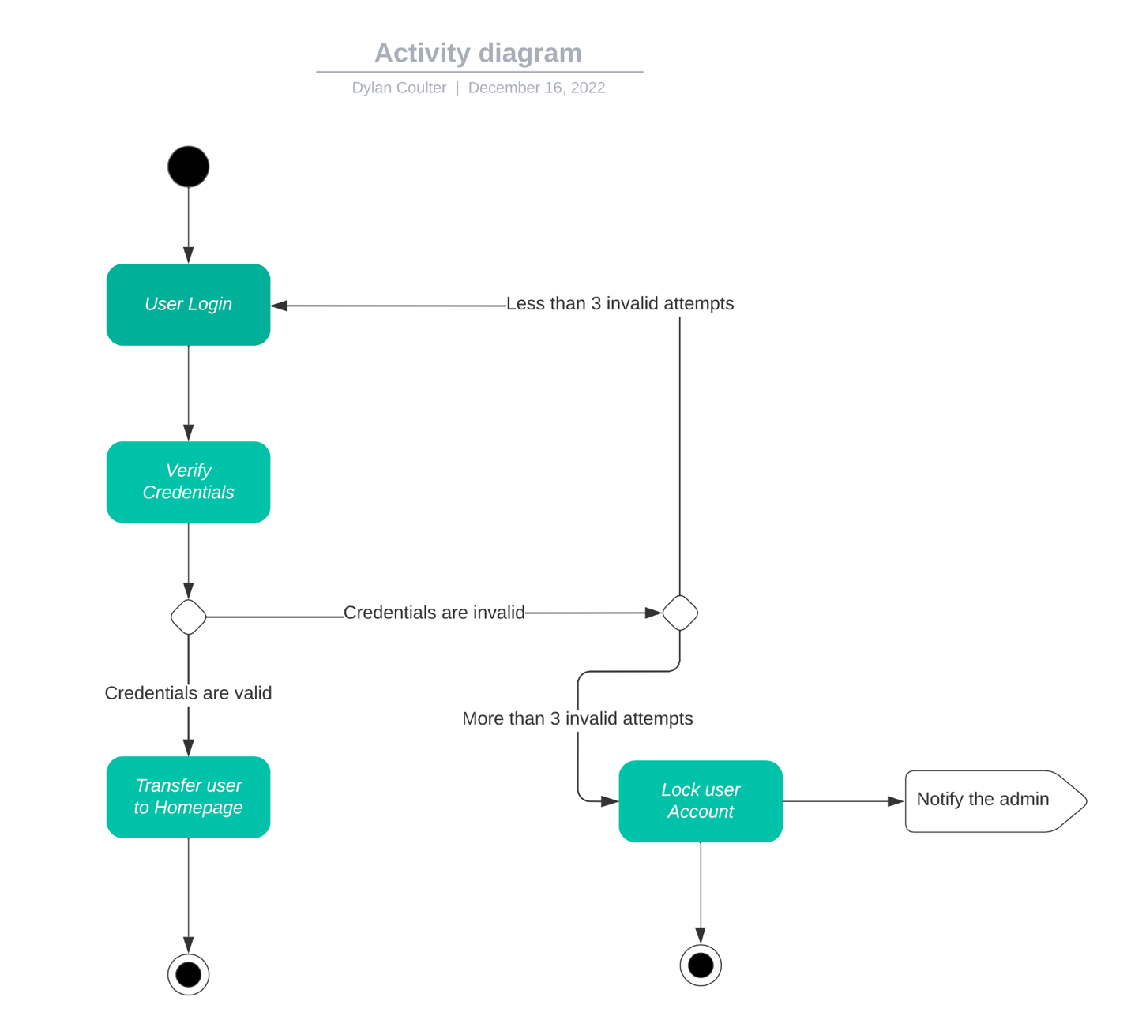
Activity Diagram
Notes:
The diagram depicted on this slide is one of the two activity diagrams created for the DriverPass system. This particular activity diagram illustrates the process of the user logging in to the system. The black dot at the top show the start of the process. Next, we have an arrow pointing to a green box which represents the user engaging the system to log in. Once the user enters their credentials they will be verified they are correct. If the user's credentials are incorrect, they will be brought back to log in screen unless they have attempted three failed log in attempts in which case they would be locked out and the admin will be notified. If the credentials are correct the user will be brought to the homepage.

Slide 5
Security
The system will require every user to have a username and complex password.
The system must have multi-factor authentication
The cloud the system is utilizing will must be responsible for data exchanges between the client and server.
Brute force attacks a common way of effecting a system so users accounts must be locked after a certain amount of failed log in attempts. This could be set to an amount such as four failed log in attempts.
Encryption of the user's connection will be utilized for added data security.
The user will be able reset their password if forgotten through a link provided by the system. The owner and IT officer will also have the clearance to do this for users.
Notes:
Security is integral to any system especially on that has the amount of user data that DriverPass contains. Security measures that must be considered to protect the system and its users are requiring each user to have a username with a complex password. The system must require the user to present two or more piece of evidence for authentication. The cloud system must be responsible for the data exchanges between the user and the system. A common security issue is something call a brute for attack which is when an account has multiple attempted log in crashing the system. The security measure taken here would be to lock the user out after three or more failed log in attempts. The user’s connection to the DriverPass system must be encrypted to add more data security to the system. When users forget their password, they will have the ability to reset it with a provide link within the system. The owner and IT officer will also have the ability to make changes to users’ accounts such as unlocking and changing passwords.

Slide 6
System Limitations
A budget was not indicated, and we only have five months to complete the project.
The time frame given of five months and the amount of team members working on the system is concerning. More people must be included on the project.
We do not know what approach we will be taking to complete this project, and this could be a big limitation if the incorrect work path is chosen. The best path for this project would be to take an agile approach from the SDLC.
Passwords can be recovered, but no mention of recovering usernames if forgotten.
Notes:
Limitations of the design for the DriverPass system are the fact that no budget for the development of the system was given with a short timeframe till completion which only consist of five months. The amount of team members working on this project is minimal and the amount of team members must be increased to ensure the best product possible is delivered and it is delivered on time. There are multiple paths that can be chosen when working on a project such as the DriverPass system and the best path would be taking and agile approach from the SDLC(software development life cycle). The SDLC has many different approaches, but the agile approach is one of the most effective. When discussion what the clients wanted out of the system there was no mention of recovering the usernames if a user were to forget his or hers.

